Slide 1
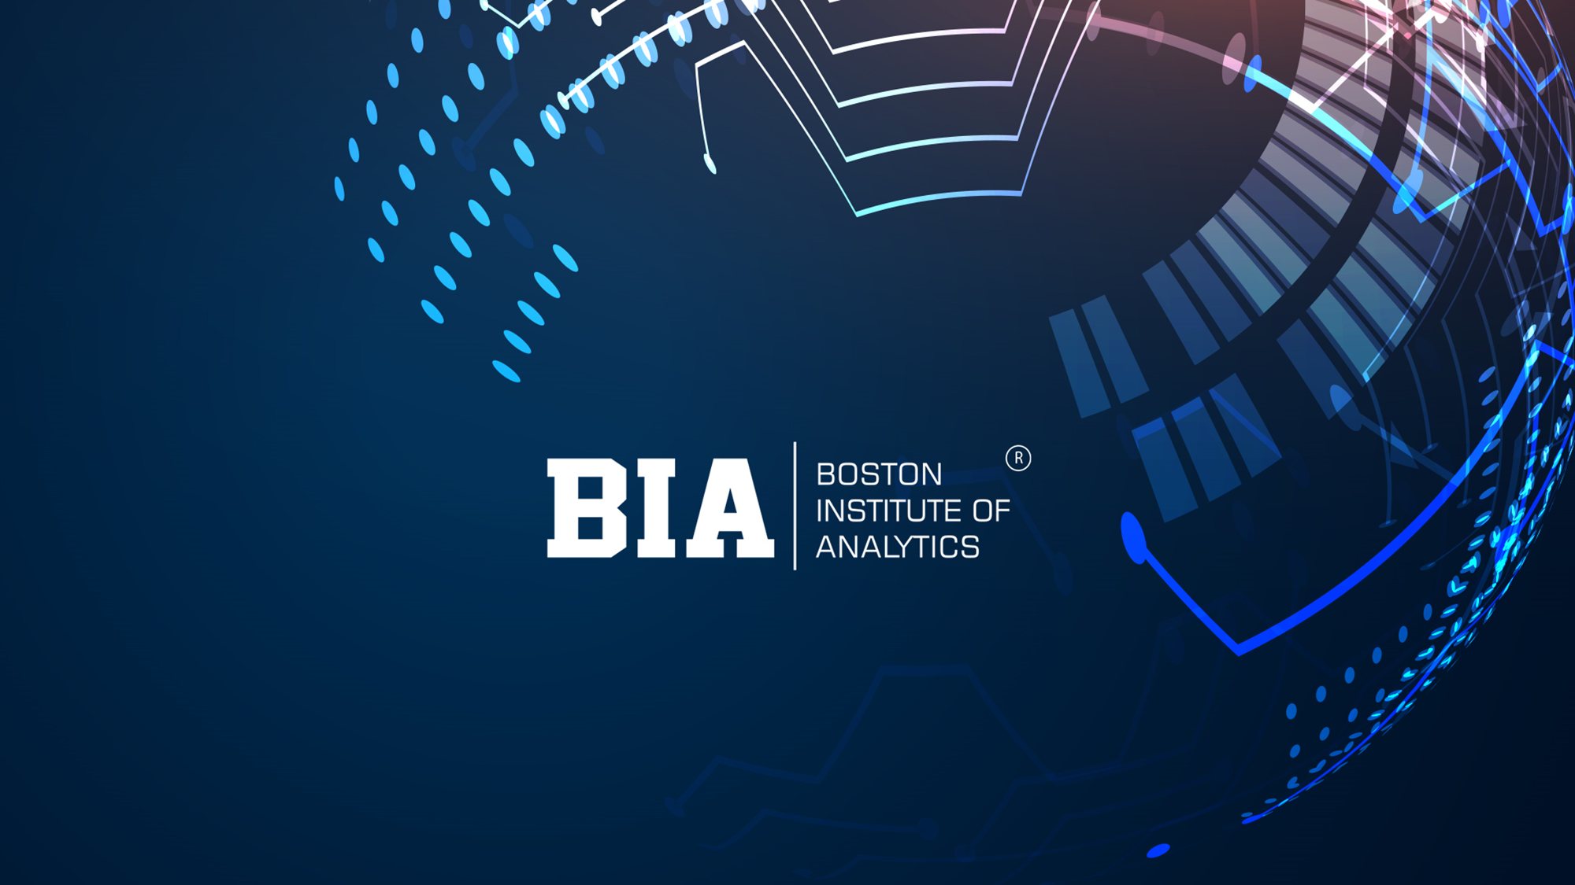

Slide 2
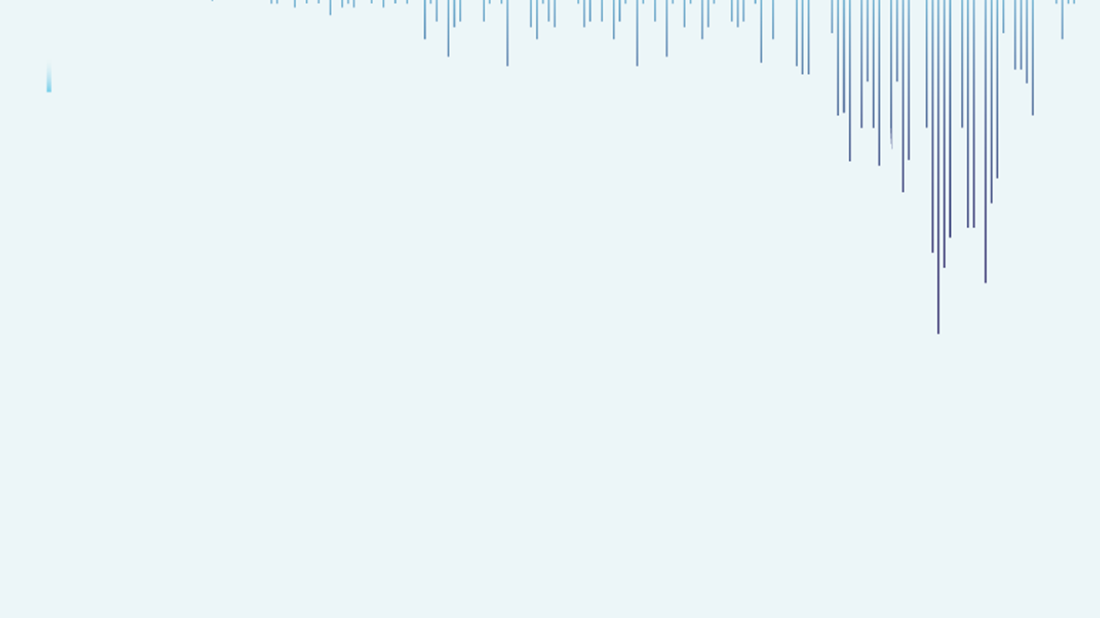

Travel Insurance Claim Prediction Using Machine Learning
By Ashish Bangera

Slide 3
ABSTRACT
Travel insurance is a popular form of insurance that provides coverage for unforeseen events that may occur during a trip. In this project, we developed a machine learning model to predict the probability of a customer making a travel insurance claim. The dataset used for building the model was imbalanced, with the majority of customers not making a claim. To address this issue, we used various data resampling techniques and evaluated multiple machine learning algorithms. Our results showed that the XGBoost algorithm performed the best, achieving an accuracy of 75% and an AUC score of 0. 747 on the test data. Feature importance analysis revealed that the destination, age, duration of the trip, and type of the travel insurance policy were the most important predictors for the claim probability. Our model can help insurance companies to better manage their risk and optimize their business processes. However, the model's performance may vary depending on the specific context and the quality of the input data

Slide 4
Objective The objective of this project is to develop a machine learning model that can predict the probability of a customer making a travel insurance claim. The model should be able to handle imbalanced data, where the majority of customers do not make a claim. The model should also be able to identify the most important features that affect the claim probability and provide insights that can help insurance companies to better manage their risk and optimize their business processes. The final model should achieve high accuracy and AUC score on the test data, and its performance should be evaluated using appropriate evaluation metrics. Problem Statement PREDICT THE CLAIM STATUS ON ALL THE IMPORTANT DEPENDENT VARIABLES.

Slide 5
Dataset Information
Target: Claim Status (Claim. Status)
Name of agency (Agency)
Types of travel insurance agencies (Agency. Type)
Distribution channel of travel insurance agencies (Distribution. Channel)
Name of the travel insurance products (Product. Name)
Duration of travel (Duration)
Destination of travel (Destination)
Amount of sales of travel insurance policies (Net. Sales)
Commission received for travel insurance agency (Commission)
Gender of insured (Gender)
Age of insured (Age)

Slide 6
Steps Performed In The Analysis
Importing Important Libraries
Load Travel Insurance Dataset
Exploratory Data Analysis
Checking the null values if any
Checking for outliers
Checking for numerical variables that impact the target variable Claim
Data Pre-processing
Data Splitting
Some Simple Random Sampling Techniques
Hyperparameter Tuning using Bayesian Optimization
Prediction of the best model using XGBoost
Getting the Confusion Matrix of the best predicted Model
Model Interpretation

Slide 7
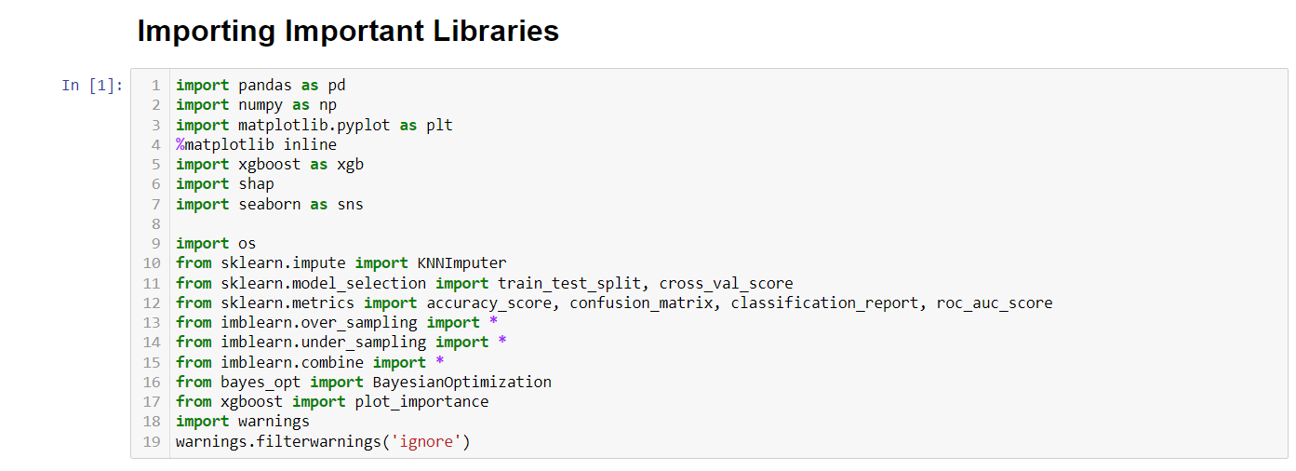
Importing Important Libraries

Slide 8
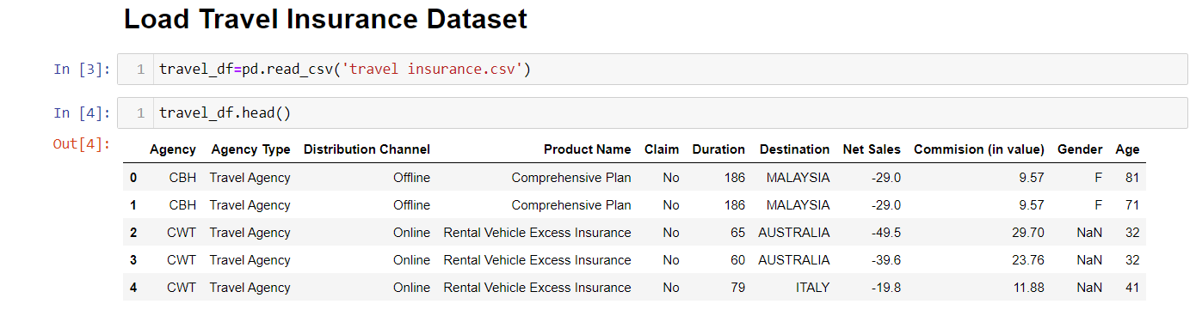
Loading the data and reading it
Exploratory Data Analysis:- Check the datatypes and columns and shapes
It has 63326 rows and 11 columns. The features or attributes include Agency, Agency Type, Distribution Channel , Product Name, Claim, Duration, Destination , Net Sales, Commission, Gender and Age . The predicted outcome is Claim.

Slide 9
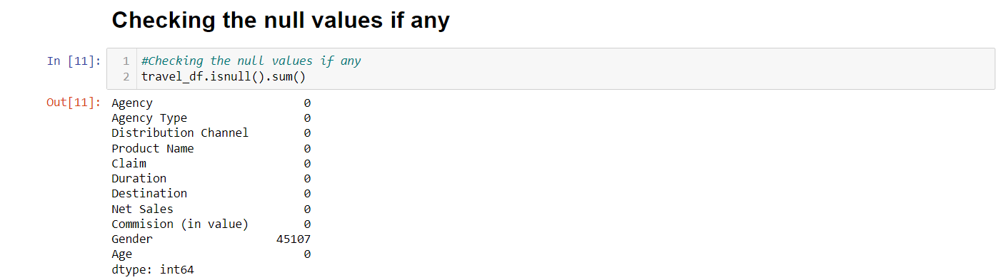
Checking the null values

Slide 10
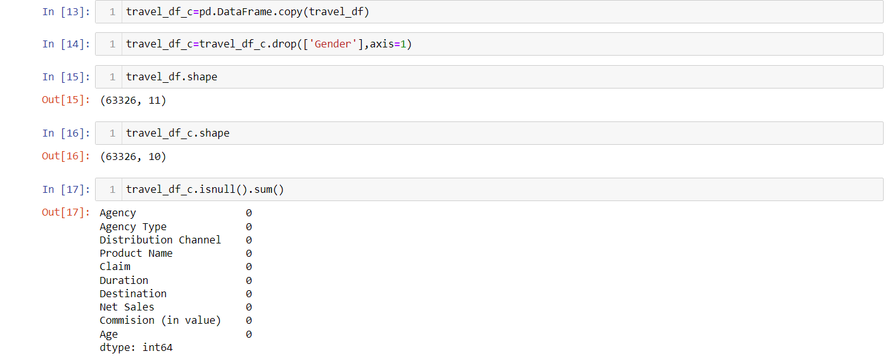
Removing the Gender column –
Here we have remove the gender column because of the large number of null values were found (45107 null values)

Slide 11
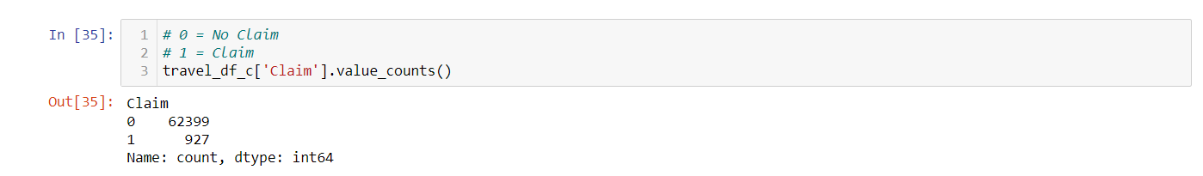
Checking the count of Target variable “Claim”:-

Slide 12
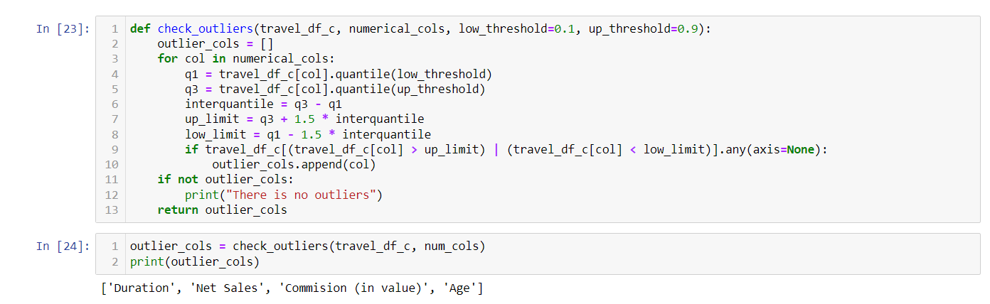
Checking for outliers :-

Slide 13
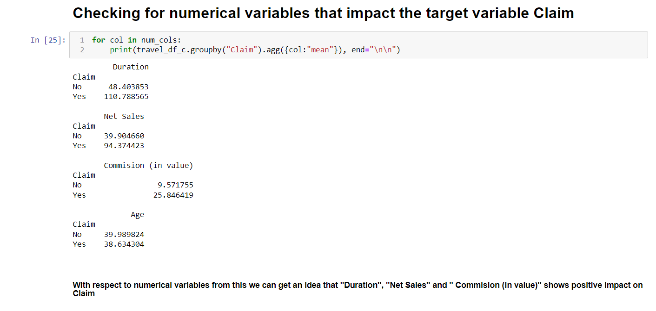

Slide 14
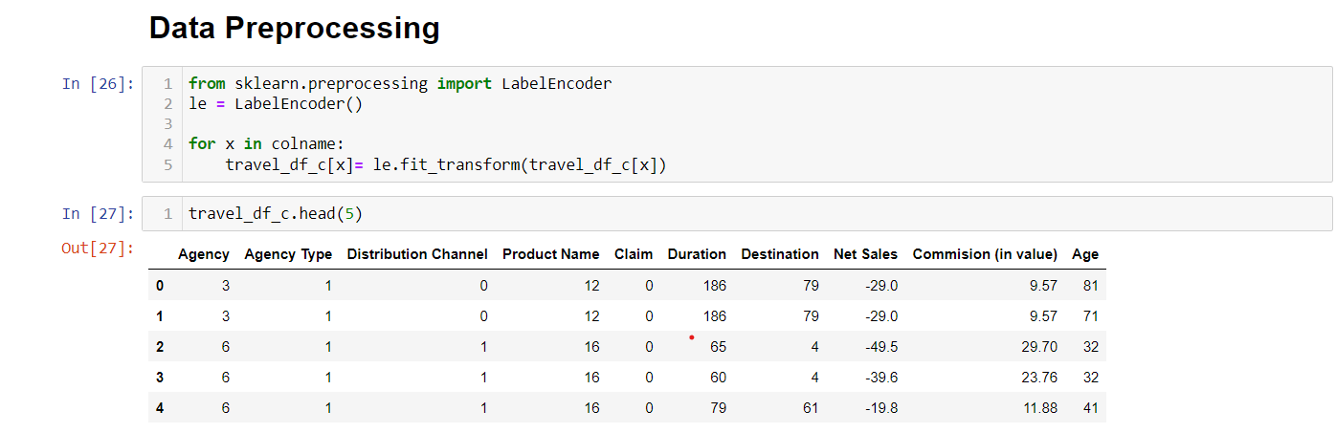
Data Pre-processing:- Using LabelEncoder to transform object datatype to numerical datatype.

Slide 15
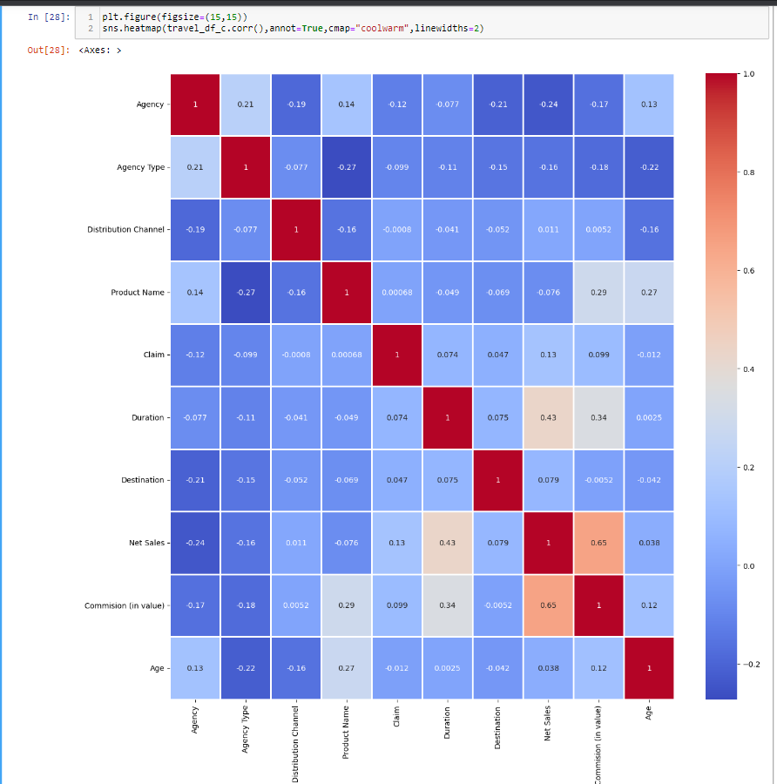
Correlation

Slide 16
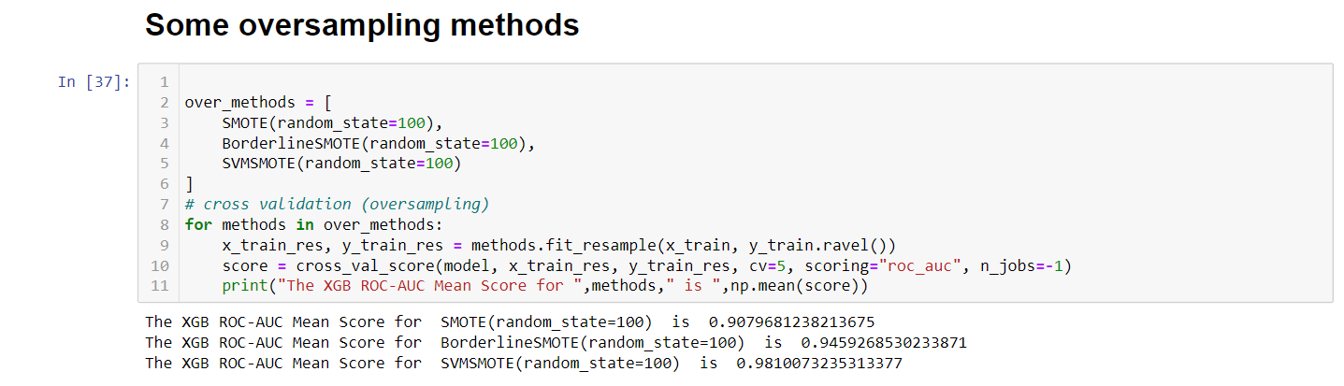
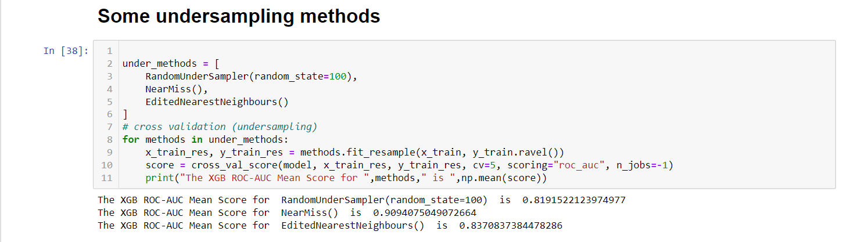

Slide 17
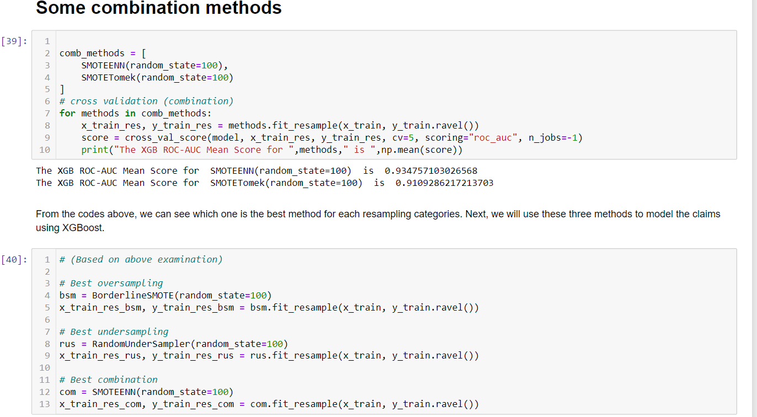

Slide 18
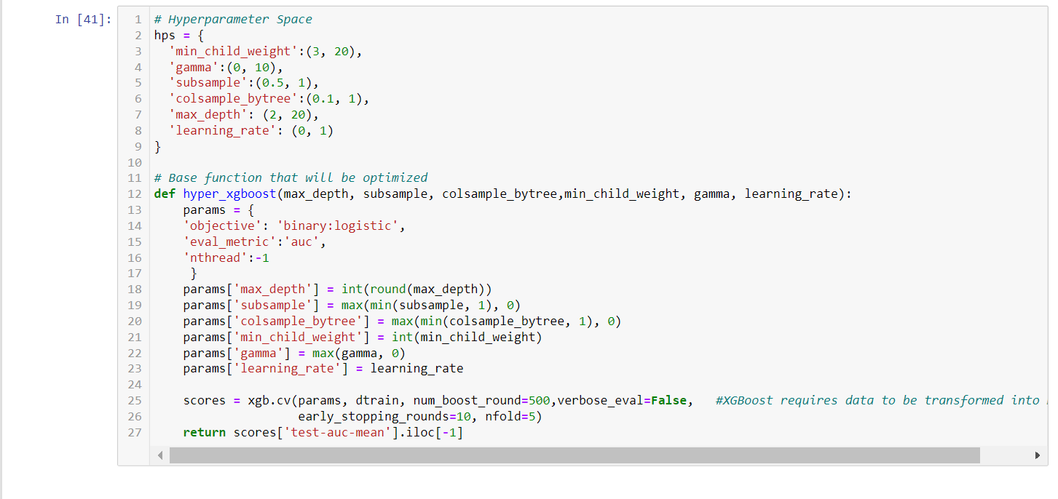
Hyperparameter Tuning using Bayesian Optimization

Slide 19
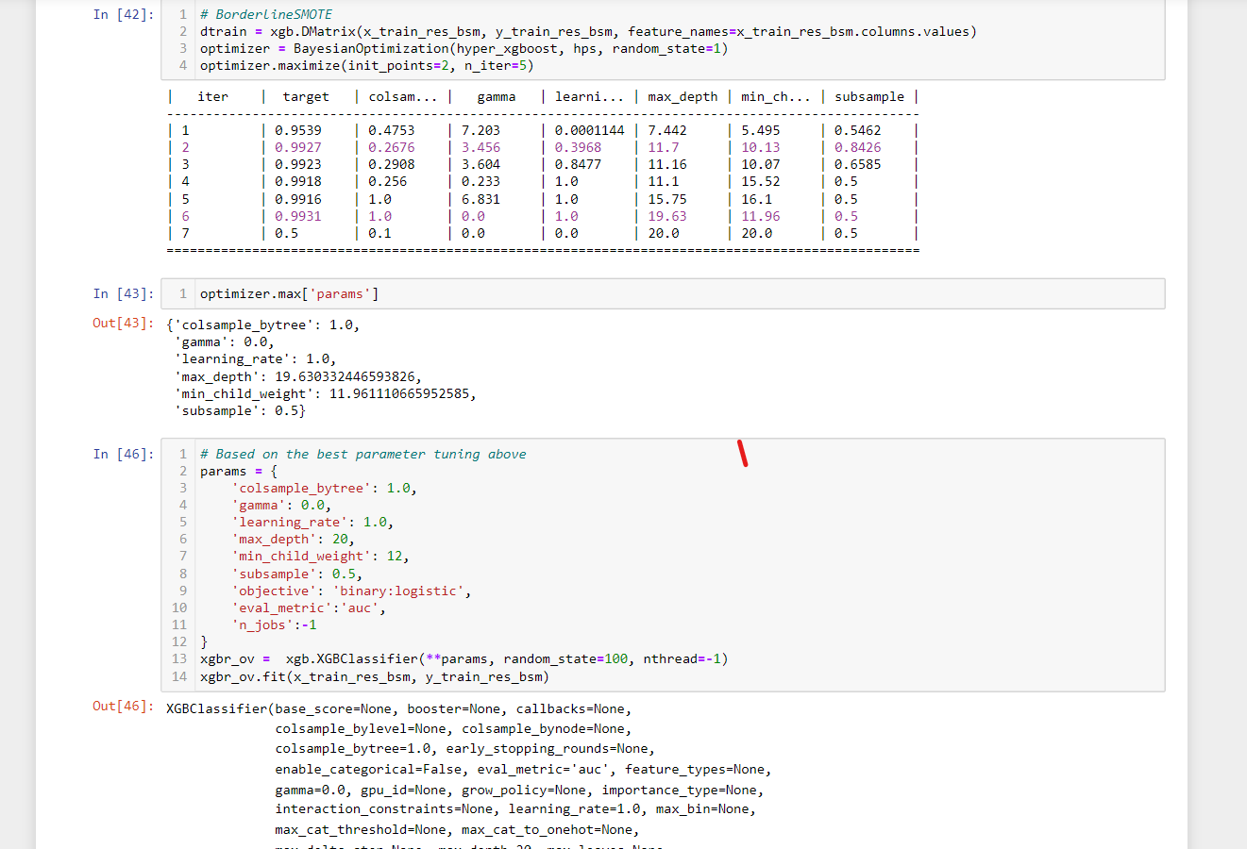
BorderlineSMOTE

Slide 20
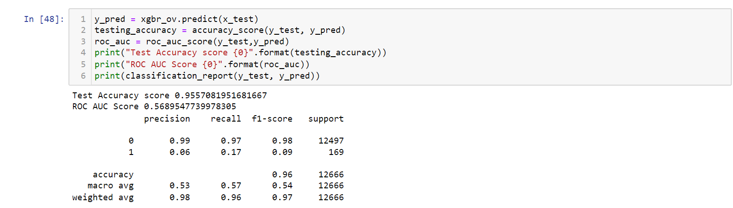
XgBoost on BorderlineSMOTE Model

Slide 21
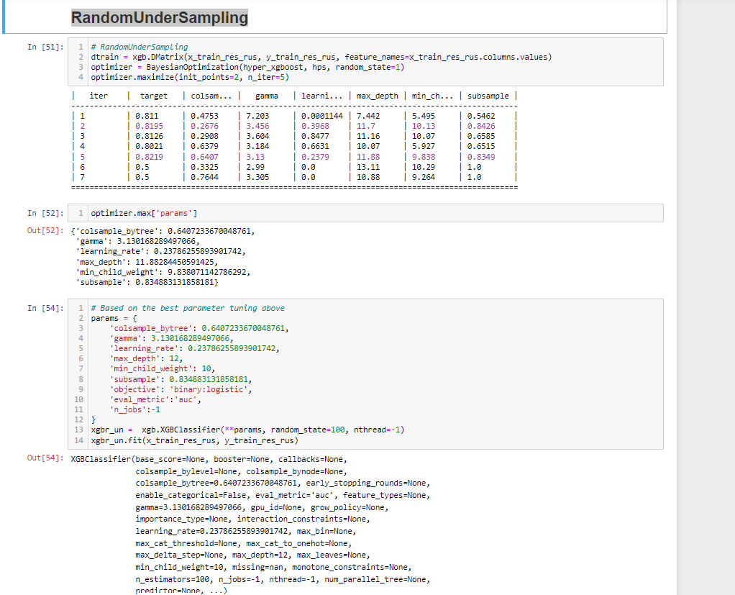
RandomUnderSampling

Slide 22
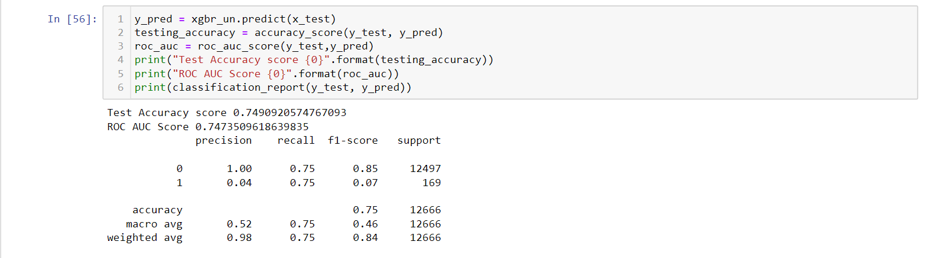
XgBoost on RandomUnderSampling Model

Slide 23
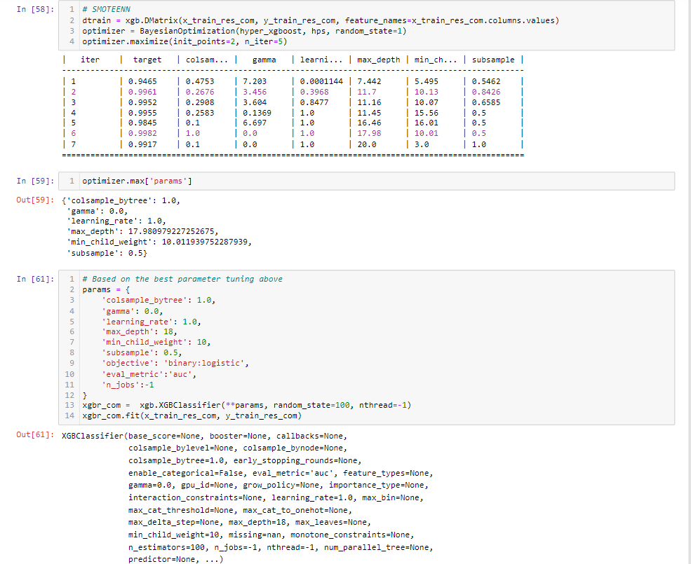
SMOTEENN

Slide 24
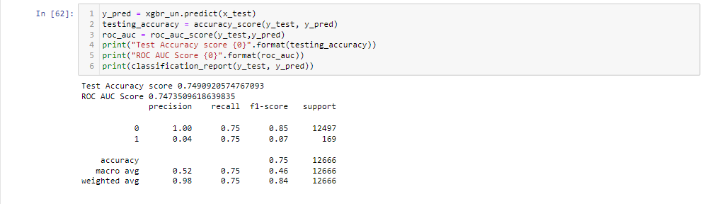
XgBoost on SMOTEENN Model

Slide 25
Confusion Matrix of the best Model-From the confusion matrix above, we can see that the model has a 75% accuracy and 75% recall, which is a good thing since in cost-sensitive learning, a conservative model is needed. On other words, since the cost of false negative (wrongly predict someone is not claiming) is higher than the cost of false positive (wrongly predict someone is claiming), a high recall is a good news.

Slide 26
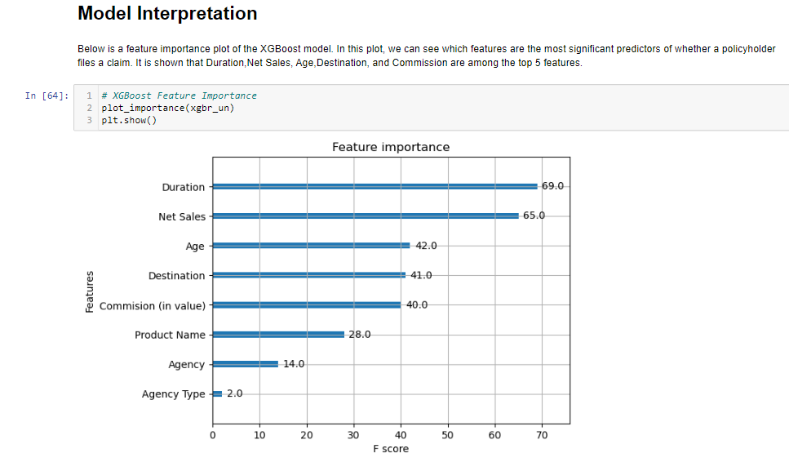

Slide 27
Results-
From the confusion matrix above, we can see that the model has a 75% accuracy and 75% recall, which is a good thing since in cost-sensitive learning, a conservative model is needed. On other words, since the cost of false negative (wrongly predict someone is not claiming) is higher than the cost of false positive (wrongly predict someone is claiming), a high recall is a good news

Slide 28
Conclusion
The problem of predicting travel insurance claim is a binary classification task where the goal is to predict whether a customer will make a claim or not. The dataset used for building the model was imbalanced, with the majority of customers not making a claim. This can lead to biased model performance, and thus, data resampling techniques were used to address this issue. Various machine learning algorithms were evaluated, and the XGBoost algorithm was found to be the best performing algorithm based on the evaluation metrics used. The feature importance analysis showed that the Duration,Net Sales, Age,Destination, and Commission were the Top 5 important features for predicting the claim probability. The final model achieved an accuracy of 75% and an AUC score of 0.747 on the test data, which indicates that it can predict whether a customer will make a claim or not with high accuracy.

Slide 29
Thank You!

